Slide 1
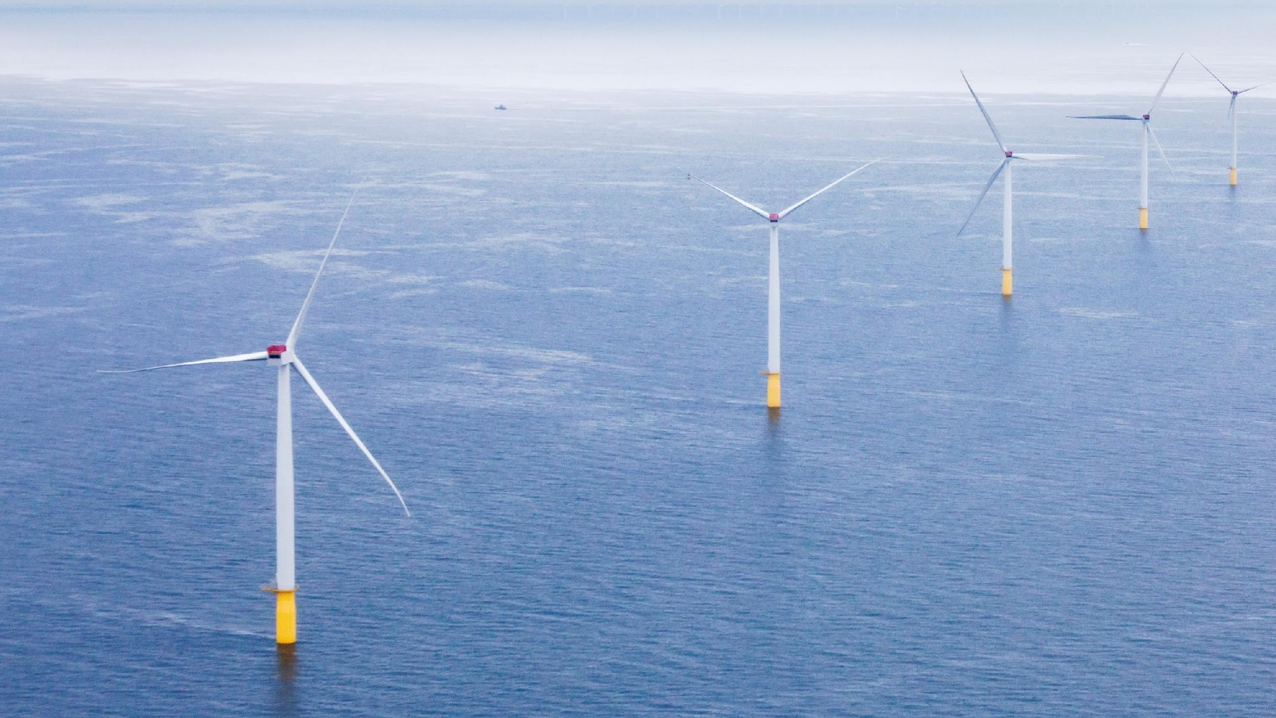
National Offshore Wind Research and Development Consortium
Overview Slides

Slide 2
NOWRDC’s Formation
The National Offshore Wind Research and Development Consortium (NOWRDC) was created in 2018 when the U.S. Department of Energy selected the New York State Energy Research and Development Authority (NYSERDA), to create a new 501©3 non-profit organization to advance offshore wind technology R&D through competitive grants.
DOE provided initial funding of $20.5 million, which NYSERDA matched to form formed a funding pool of $41 million.
Since NOWRDC’s formation, 7 states, 10 developers, and 10 other public and independent members have joined the Consortium.

Slide 3
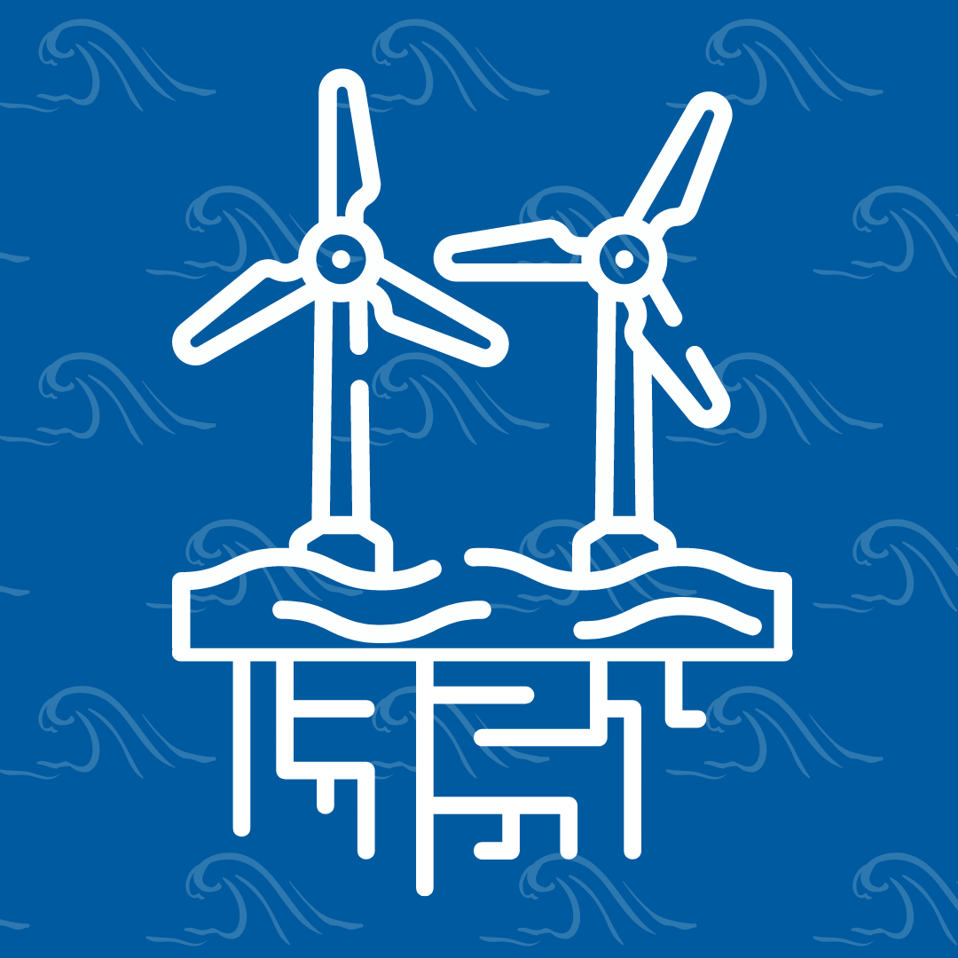
NOWRDC’s Mission
NOWRDC is a nationally-focused, not-for-profit organization collaborating with industry to fund prioritized R&D activities to:
Accelerate the deployment of offshore wind energy in the U.S.
Address challenges and obstacles facing the offshore wind industry and maximize economic and social benefits.
Reduce the levelized cost of energy (LCOE) of offshore wind in the U.S.

Slide 4
Our Core Activities
Fund innovation directly responsive to the technical and supply chain barriers faced by offshore wind project developers in the U.S.
Convene strong networks that connect technology innovators, research institutions, project developers, supply chain companies, utilities, and state and federal government agencies
Increase U.S. content and job opportunities

Slide 5
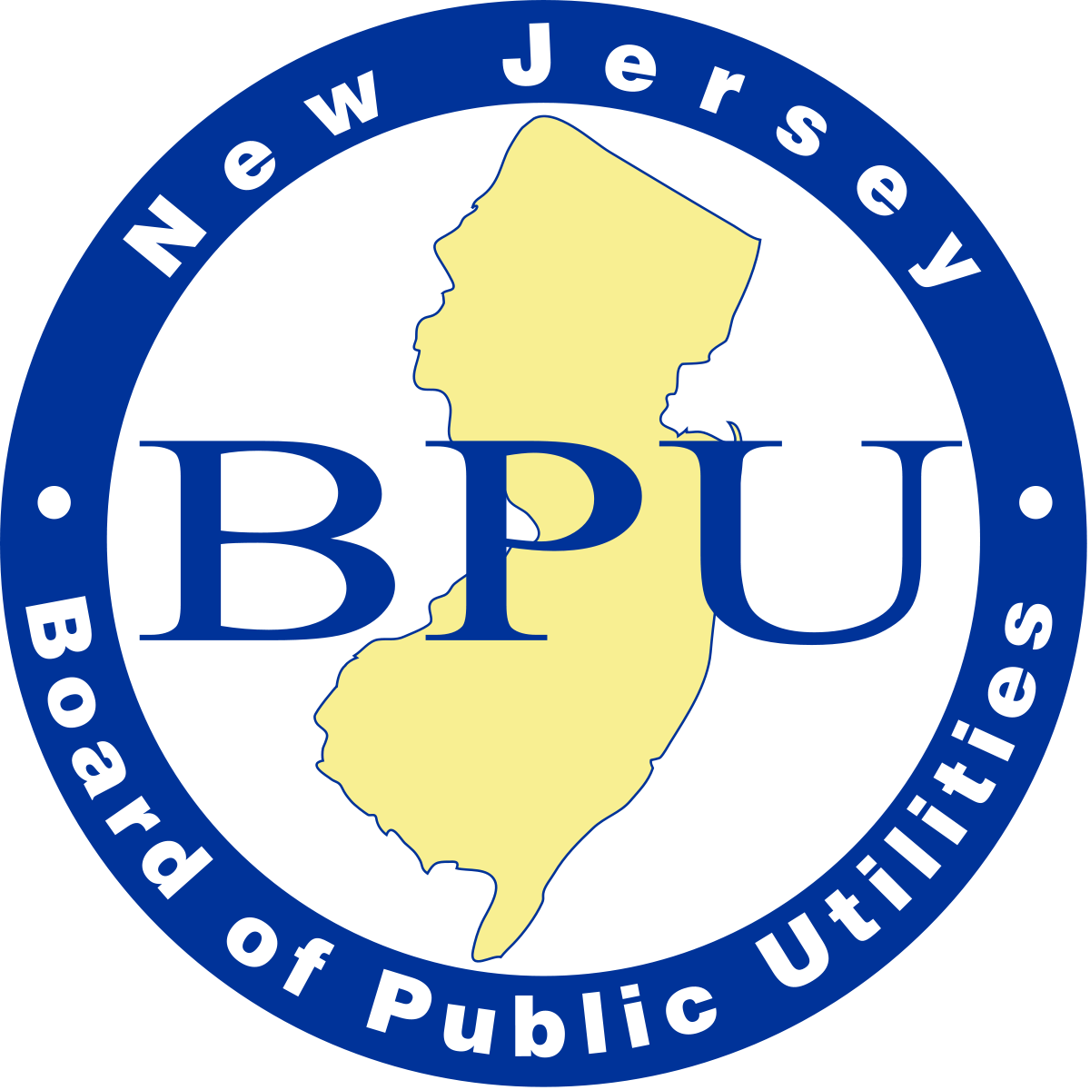
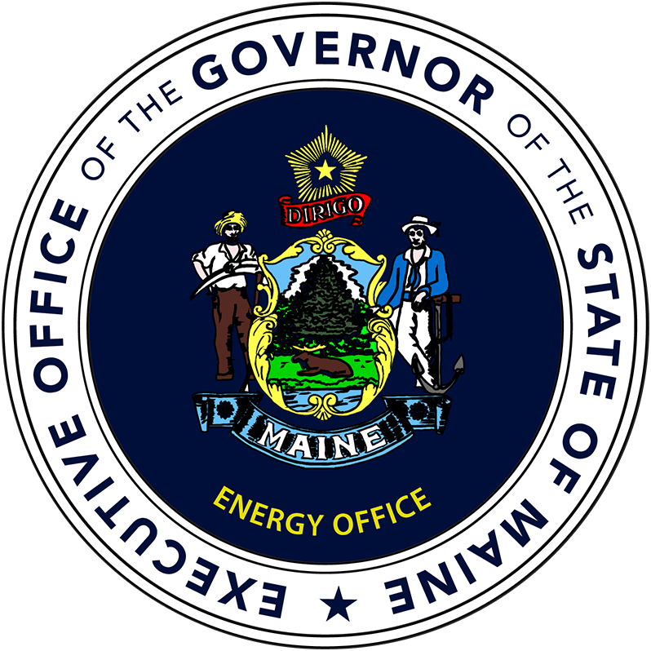
NOWRDC Members and Board
Government & Utilities
Offshore Wind Developers
Independent Offshore Wind Industry Members

Slide 6
NOWRDC Innovation Funding to Date
2018
2018 - 2024
Present
Core funding of $41M
$20.5 DOE funds, matched by NYSERDA
State funds
Contributed over $9M in additional funding for R&D grants
Initial DOE and NYSERDA R&D funds fully allocated
NOWRDC is pursuing opportunities to fund R&D
Funding Result:
4 competitive solicitations to date
Over $55M
in R&D
grant funding
Over $6M in programmatic or leveraged funds
57 project awards

Slide 7
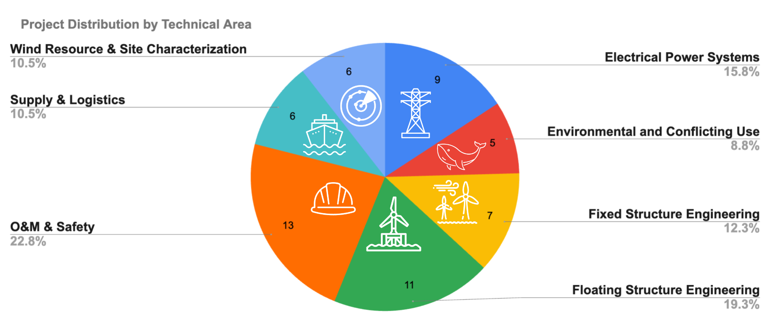
R&D Projects Funded to Date

Slide 8
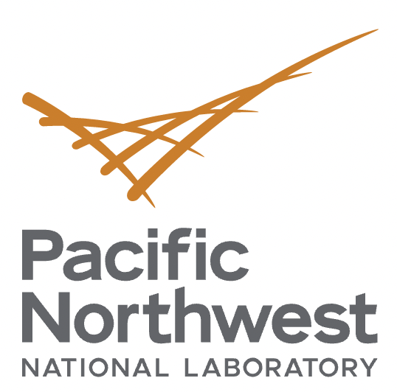
Highlighted Projects
30GW by 2030: Supply Chain Roadmap for OSW in the U.S.
An OSW Development Strategy to Maximize Electrical System Benefits in Southern Oregon and Northern California
Demonstration of Mooring Components for Floating Offshore Wind
Project Timeline: Q2 2021 – Q1 2023
Cost Sharing Entity: Maryland
Key Outcomes: The Roadmap supports a unified approach to building a domestic supply chain will be critical for establishing port, vessel, factory, and workforce resources that can be developed in a timely, just, and sustainable way, and identifies the challenges that will have to be overcome to achieve a domestic supply chain.
Project Timeline: Q4 2021 – Q3 2023
Cost Sharing Entity: BOEM
Key outcome: This project will evaluate and recommend optimized transmission scenarios to deliver offshore wind to west coast load centers
Project Timeline: Q3 2021 – Q3 2024
Cost Sharing entity: Aker Solutions, Principle Power and Technology From Ideas
Key outcome: This project will develop, test and demonstrate a polymer spring technology to improve mooring modeling capabilities for floating technologies.

Slide 9
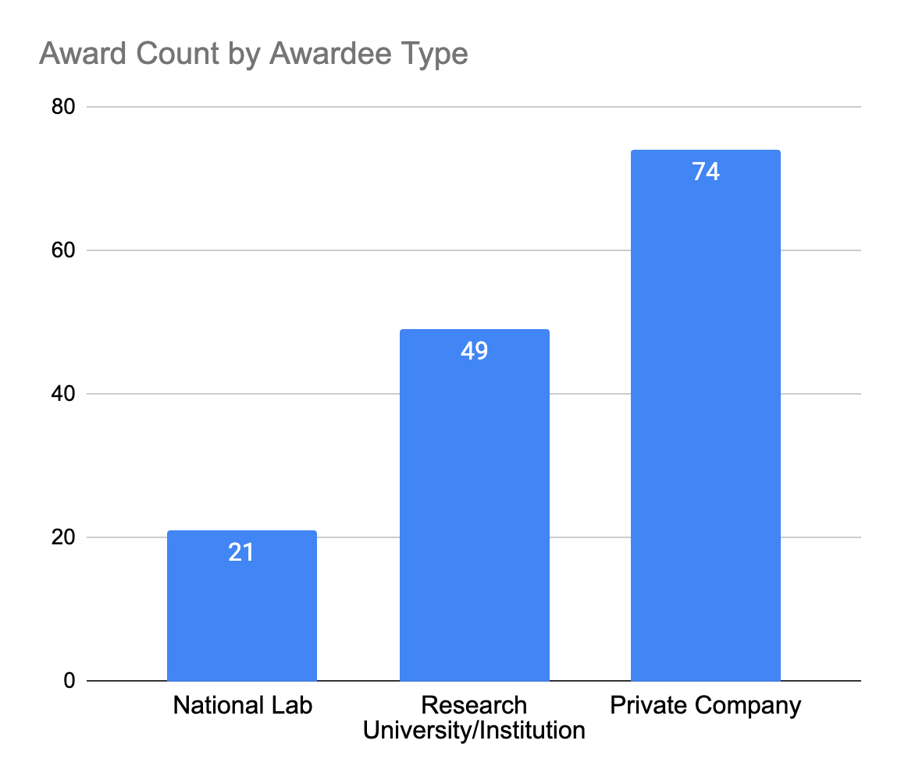
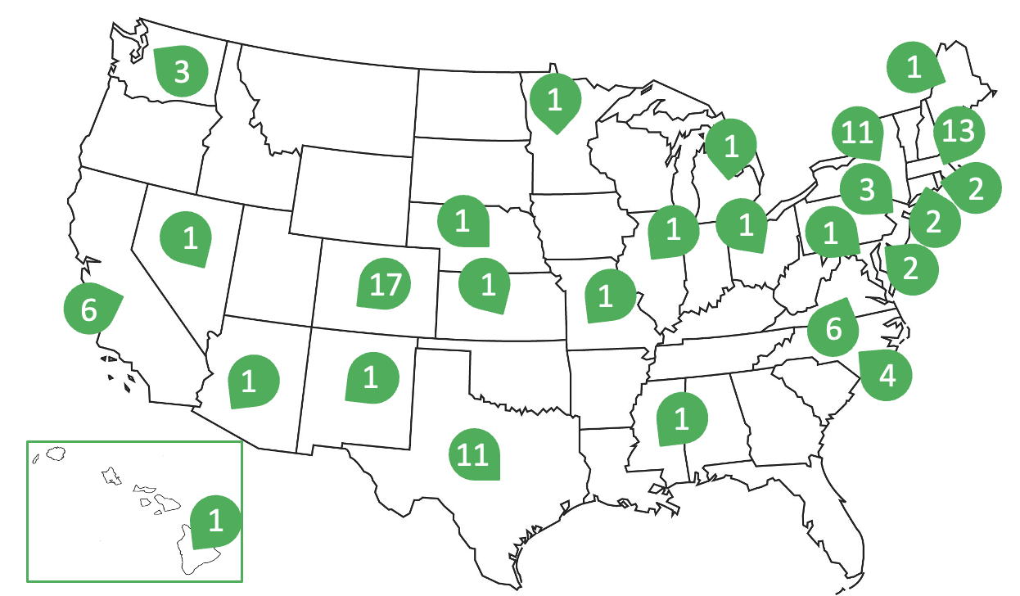
Project Map & Awardee Distribution
*Includes prime awardees and subcontractors
*National Lab awardees include National Renewable Energy Laboratory, Sandia National Laboratory, and Pacific Northwest National Laboratory

Slide 10
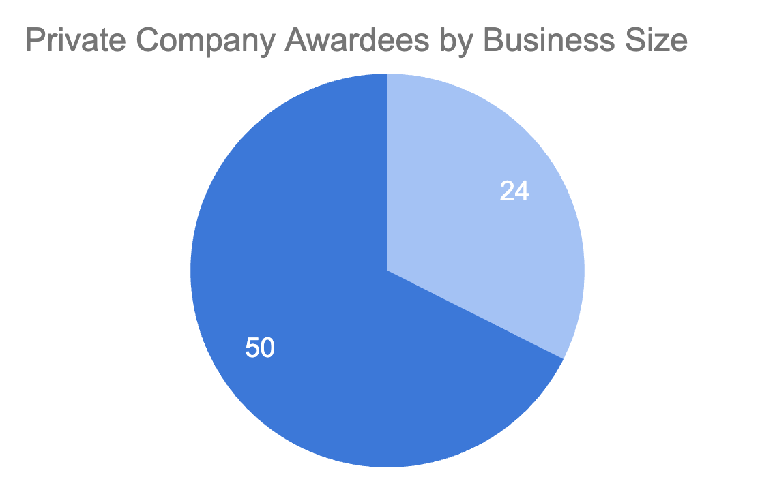
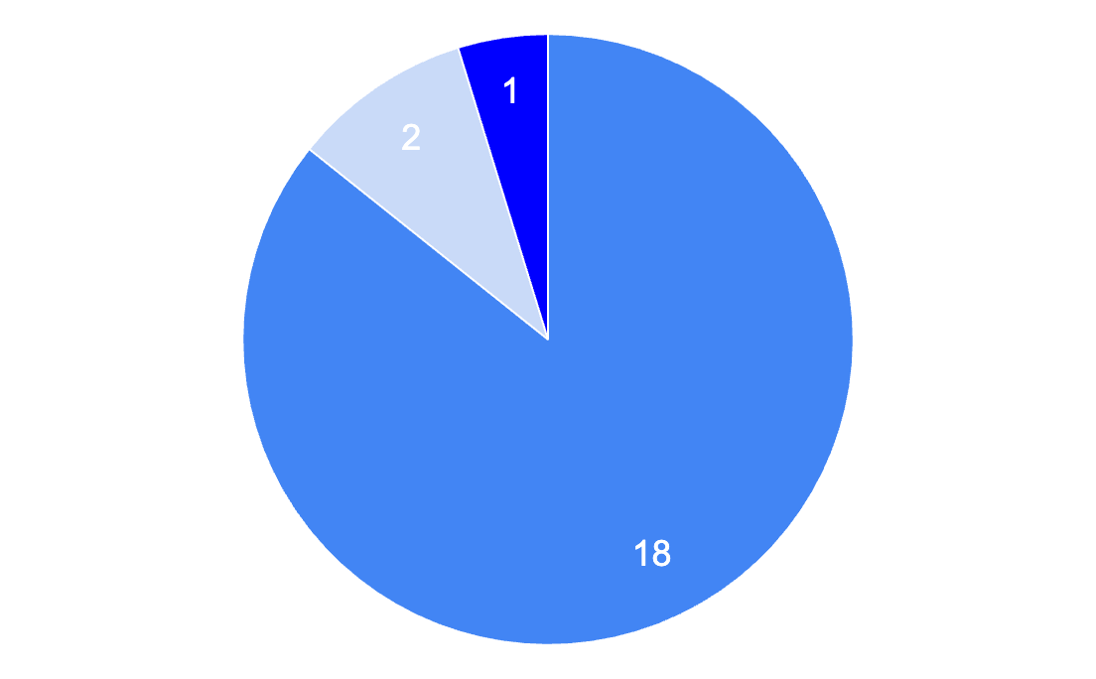
Project Map & Awardee Distribution
*Includes prime awardees and subcontractors
NOWRDC has successfully engaged small businesses and given them a foothold in the emerging American OSW supply chain.
National Lab Awardees by National Lab
Private Business Awardees by Business Size
Sandia
PNNL
Medium and Large Business Awardees
(1500< employees)
Small Business Awardees
(<1500 employees)
NREL

Slide 11
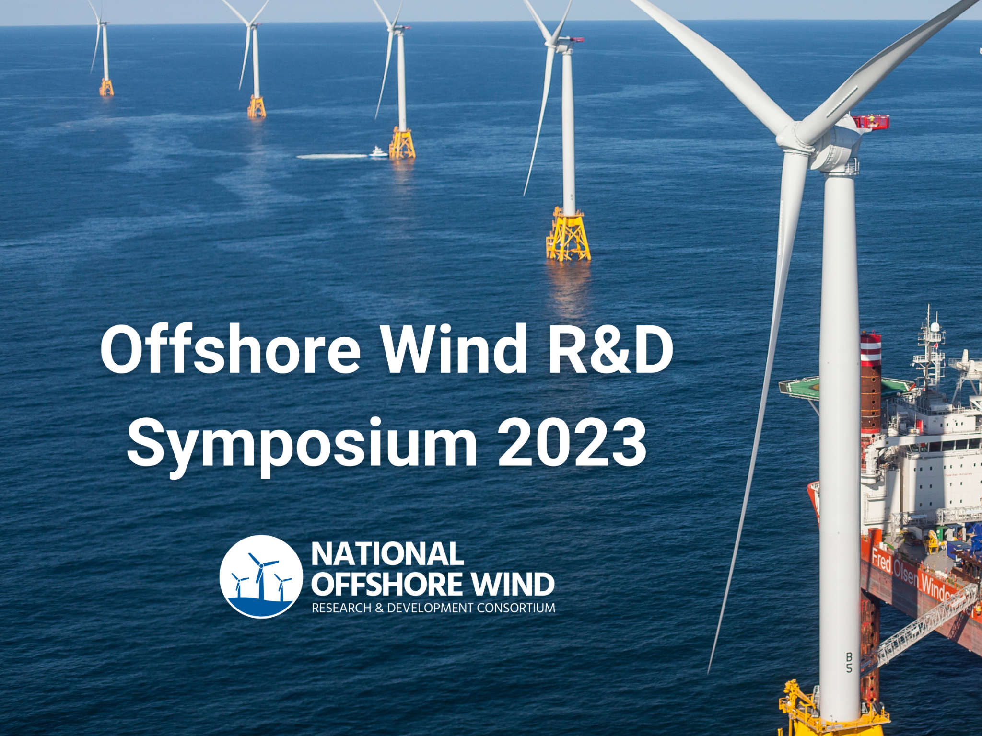
Deploying Project Results
NOWRDC has created effective means for sharing project results with the offshore wind industry:
Project Advisory Boards
Approximately 125 project advisors across NOWRDC’s project portfolio, primarily SMEs within OSW developers
An average of 6 external industry advisors on each project
Project Database
Accessible repository on NOWRDC’s website with key info on all projects for industry to use
Annual National Offshore Wind R&D Symposium
Multi-day conference showcasing NOWRDC’s project portfolio and bringing together researchers to learn from each other
Over 1,200 registrants for the past two years.
The fifth annual Symposium will be hybrid, in-person in early December 2023 with a virtual livestream option.
Increase U.S. content and job opportunities

Slide 12
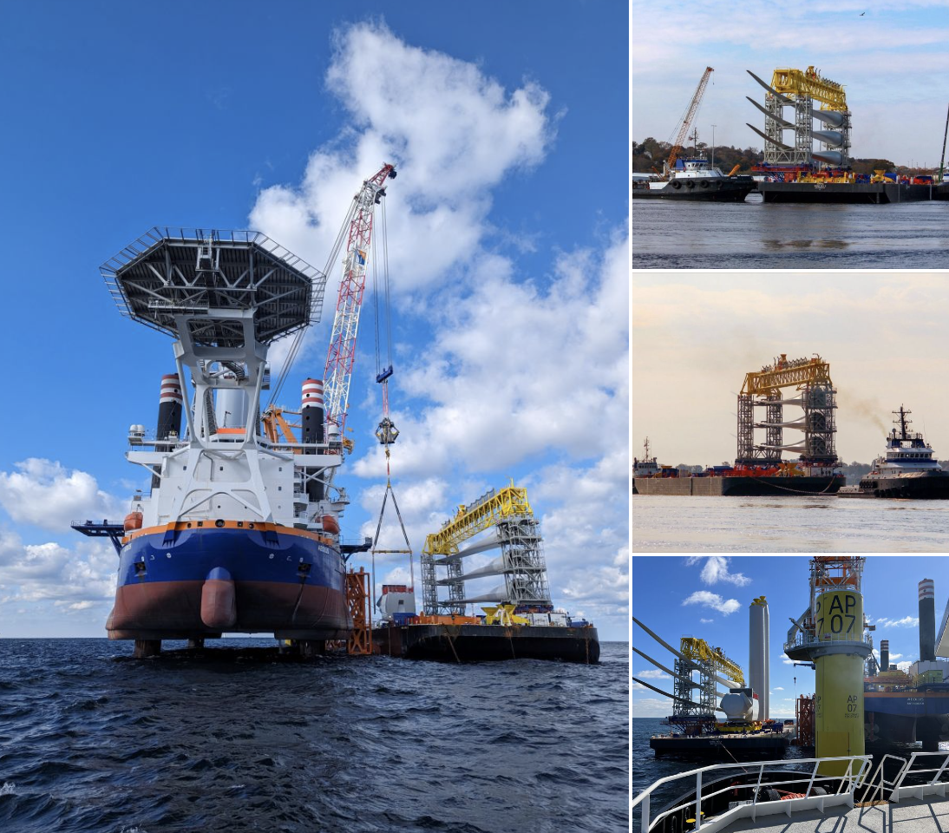
NOWRDC’s Project with Crowley Instrumental in South Fork Wind Farm
The NOWRDC Project: NOWRDC’s project with Crowley, "Technical Validation of Existing U.S. Flagged Barges as a 'Feeder' Solution for the U.S. Offshore Wind Industry," focused on the feasibility of using minimally modified U.S.-flagged barges, accompanied by tugs, to efficiently deliver WTGs to WTIVs offshore.
The Findings: A Cargo Feeder System (CFS) comprising a lead tug, a deck cargo barge loaded with WTG components, and a support tug can effectively deliver to WTIVs, enhancing the installation process. This approach not only streamlines operations but significantly reduces downtime and costs, leveraging existing vessels to keep WTIVs continually erecting wind generators.
The Deployment: Thanks to this innovative "feeder" solution, Crowley successfully transported WTGs for the 132 MW South Fork Wind Farm, utilizing U.S.-flagged vessels and operated by the skilled members of the Seafarers International Union.

Slide 13
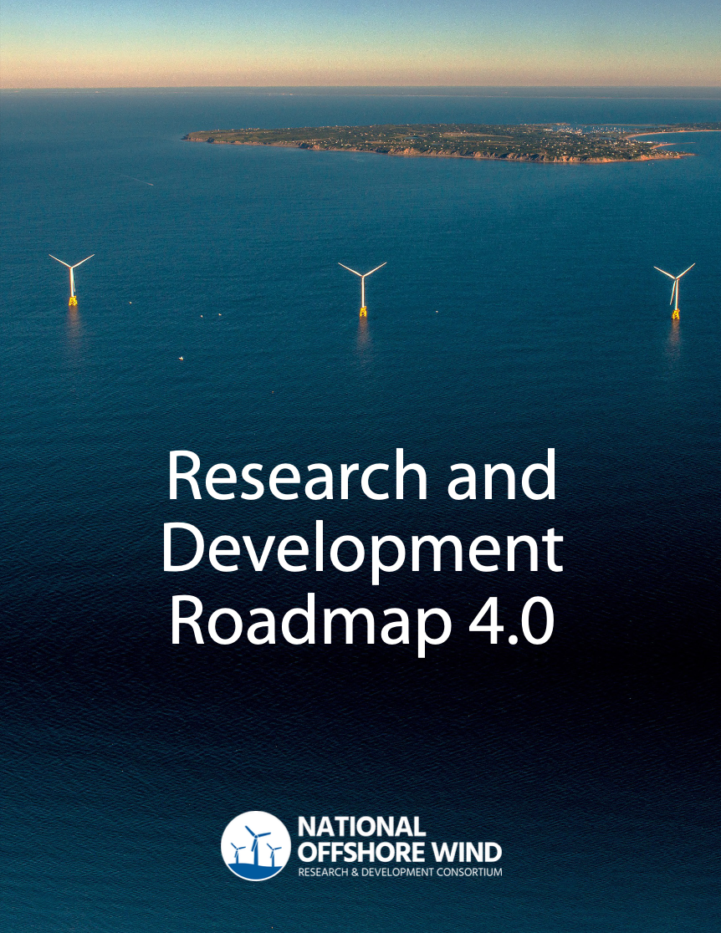
Research and Development Roadmap 4.0
NOWRDC’s R&D Roadmap serves as our overarching technical guidance document
Specifically focused on technology advancement in 3 pillars:
Pillar 1: Offshore Wind Farm Technology Advancement
Pillar 2: Offshore Wind Power Resource and Physical Site Characterization
Pillar 3: Installation, Operations and Maintenance, and Supply Chain
The Roadmap is updated approximately every 2 years
Version 4.0 was released in April 2023
Increase U.S. content and job opportunities

Slide 14
New Project Approaches - Novel Approaches to Delivering on Mission (1/2)
Denmark-
American Offshore Wind Collaboration
Equinor OSW Innovation Hub
Ocean Sensing Technology Accelerator
Inter-Array Wake Modeling JIP
NOWRDC has co-formed a joint industry project with NREL and Cornell University, bringing industry and the public sector together to analyze inter-array impacts and how to mitigate them
NOWRDC is partnering with Karp Strategies and the Xodus Group to develop an ocean-sensing technology accelerator with funding from the IOOS OCRA Program.
NOWRDC has partnered with the Danish Technical Institute (DTU) to co-develop an offshore wind technology roadmap for the Danish government.
NOWRDC is an official partner of the Equinor Offshore Wind Innovation Hub, in Brooklyn, NY. NOWRDC provides technical guidance and network support.

Slide 15
New Project Approaches - Novel Approaches to Delivering on Mission (2/2)
NOWRDC is running a joint solicitation with Innovate UK
The solicitation aims to catalyze offshore wind innovation that responds to common challenges in the UK and the U.S.
Solicitation will procure projects that will be based in both the UK and the U.S., focused on mutual offshore wind challenge areas
Total available funding is targeted at $4-8M, equal parts U.S. and UK funding
NOWRDC is currently discussing challenge areas and available funding with state members
Applications are due January 2024
Joint solicitation supports the spirit of the U.S.-UK Strategic Energy Dialogue, aimed at enhancing and expanding cooperation in support of shared energy security and resilience objectives, clean energy and net zero ambitions, and joint leadership priorities in multilateral energy forums

Slide 16
Industry Member Benefits
Ability to identify industry needs to steer NOWRDC’s R&D funds and resulting project awards
Participation in NOWRDC network comprised of federal, state, and industry partners that provide value beyond technical R&D
Main points of interaction include Board of Directors (quarterly), R&D Committee (monthly), and project advisory boards (opt-in per project, quarterly)
Real time access to technical innovation and direct connection with technology developers (full awardee list linked here)

Slide 17
State Member Benefits
Participation in Board of Directors, R&D Committee, and State Action Network
Network connections that provide value beyond technical R&D
Ability to steer NOWRDC’s R&D agenda and resulting project awards
Opportunities to leverage funding and form collaborative innovation programs with other states and countries

Slide 18
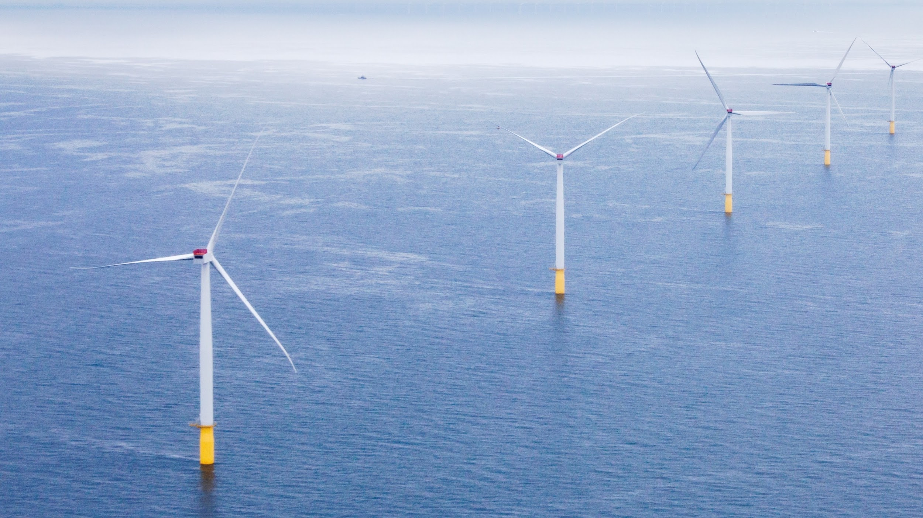
Thank you
NOWRDC’s full project database is available here:
https://nationaloffshorewind.org/project-database/

Slide 19
Appendix I: NOWRDC Projects by Technical Challenge Area

Slide 20
NOWRDC Projects: Transmission and Grid Stability
Contractor | Project Title
NREL | Development of Advanced Methods for Evaluating Grid Stability Impacts
PNNL | An Offshore Wind Energy Development Strategy to Maximize Electrical System Benefits in Southern Oregon and Northern California
GE Research | DC Collection and Transmission for Offshore Wind Farms
Tufts University | Transmission Expansion Planning Models for Offshore Wind Energy
Offshore Wind Consultants | Shared Landfall and Onshore Cable Infrastructure for Cable Colocation Feasibility Study
ThayerMahan | Transmission and Export Cable Fault Detection and Prevention Using Synthetic Aperture Sonar
University of Michigan | Robust Stabilization of Subsea Power Cables using Nonlinear Energy Sinks
Clarkson University | Atlantic seaboard offshore stability risk evaluation & service
Rutgers University | AIRU-WRF: AI-powered Physics-based Tool for OSW Forecasting and Grid Integration

Slide 21
NOWRDC Projects: Ocean Area Coexistence
Contractor | Project Title
CODAR Ocean Sensors LTD | Oceanographic HF Radar Data Preservation in Wind Turbine Interference Mitigation
Advisian | Technology Development Priorities for Scientifically Robust and Operationally Compatible Wildlife Monitoring and Adaptive Management
Cornell University | Right Wind: Resolving Protected Species Space-Use Conflicts in Wind Energy Areas
Northeastern University | Long-Term Availability and Bankability of Offshore Wind Through Hurricane Risk Assessment and Mitigation
Saildrone | Renewable Powered, Uncrewed Mobile Assets to Monitor Protected Marine Mammals
NREL | Co-Design Solutions for U.S. Floating Offshore Wind and Fishing Compatibility

Slide 22
NOWRDC Projects: Fixed Structure Engineering
Contractor | Project Title
ESTEYCO SL | Self-Installing Concrete Gravity-Base Substructure Sizing for 15MW Turbine
Texas A&M | Vibratory-Installed Bucket Foundation for Fixed Foundation Offshore Wind Towers
Keystone Tower Systems | Tapered Spiral Welding for US Offshore Wind Turbine Towers
DEME Offshore US LLC | Tri-Suction Pile Caisson Foundation Concept
RCAM Technologies | A Low-Cost Modular Concrete Support Structure and Heavy Lift Vessel Alternative
Stony Brook University | Computational Control Co-design Approach for Offshore Wind Farm Optimization
NREL | Wind Farm Control and Layout Optimization for U.S. Offshore Wind Farms

Slide 23
NOWRDC Projects: Floating Structure Engineering
Contractor | Project Title
PCCI, Inc. | Quarter Scale Testing of the Intelligent Mooring System for FOWT Platforms
ESTEYCO | Evolved Spar Concrete Subconstructure for Floating Offshore Wind US-Based Design
Deep Reach Technology | Application of Novel Offshore Oil & Gas Platforms to Large Wind Turbines
Virginia Tech | Dual-Functional Tuned Inerter Damper for Enhanced Semi-Sub Offshore Wind Turbine
NREL | Standardized Scalable Mooring Solutions Optimized for the U.S. Supply Chain
NREL | Shared Mooring Systems for Deep-Water Floating Wind Farms
Principle Power, Inc. | Innovative Deepwater Mooring Systems for Floating Wind Farms (DeepFarm)
Principle Power, Inc. | Demonstration of Shallow-Water Mooring Components for FOWTs (ShallowFloat)
UMass Amherst | Techno-Economic Mooring Configuration and Design for Floating Offshore Wind
Triton Systems, Inc | Innovative Anchoring System for Floating Offshore Wind
University of Maine | Design and Certification of Taut-synthetic Moorings for Floating Wind Turbines

Slide 24
NOWRDC Projects: O&M and Safety
Contractor | Project Title
ULC Robotics | UAS to Transform Offshore Wind
GE Renewable Energy | Self-Positioning Single Blade Installation Tool
GE Research | Autonomous Vessel-Based Multi-Sensing System for Inspection and Monitoring
UMass Lowell | A Novel Structural Health Monitoring System for Offshore Wind Turbine
Anduril Industries Inc. | Fully Autonomous Subsea Asset Inspection by a Shore-Launched AUV
Tagup Inc. | Survival Modeling for Offshore Wind Prognostics
GE Research | Enabling Condition Based Maintenance for Offshore Wind
GE Research | Radar Based Wake Optimization of Offshore Wind Farms
Tufts University | Physics Based Digital Twins for Optimal Asset Management

Slide 25
NOWRDC Projects: Supply and Logistics
Contractor | Project Title
NREL and BNOW | 30GW by 2030: Supply Chain Roadmap for Offshore Wind in the US
Crowley | Technical Validation of Existing U.S. Flagged Barges as a “Feeder” Solution for the U.S. Offshore Wind Industry
Exmar Offshore Company | Feasibility of a Jones Act Compliant WTIV Conversion
MARIN USA | Comparative Operability of Floating Feeder Solutions
GE Renewable Energy | Weld Assembly of Large Castings
EPRI | Verifying OSW Turbine Blade Integrity During Manufacture

Slide 26
NOWRDC Projects: Wind Resource and Site Characterization
Contractor | Project Title
NREL | A Validated National Offshore Wind Resource Dataset with Uncertainty Quantification
GE Research | Impact of Low Level Jets on Atlantic Coast Offshore Wind Farm Performance
Cornell University | Reducing LCoE from Offshore Wind by Multiscale Wake Modeling
WHOI | Development of a Metocean Reference Site near the MA & RI Wind Energy Areas

Slide 27
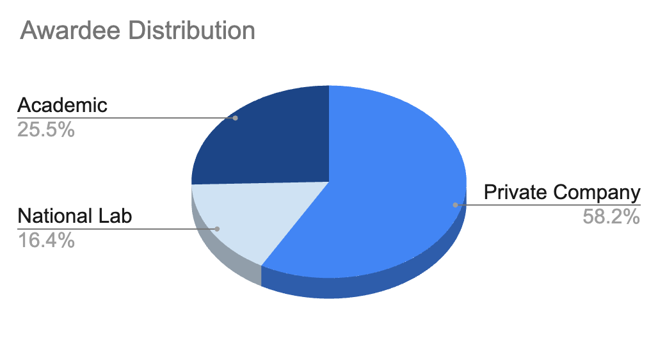
R&D Projects Funded to Date
Notes:
Floating and transmission are where we have the most projects, reflecting industry need and national priorities.

Slide 28
Appendix II: NOWRDC Board Members and Staff

Slide 29
NOWRDC Board Members
Scot Hewitt-Gudgin, Senior Director, U.S. Offshore Business Project Services at Avangrid Renewables
Antoine Cognard – Senior Director, Offshore Implementation at EDF Renewables
Sam Aronson – Director emeritus, Brookhaven National Lab
Jan Matthiesen – Director at the Carbon Trust
Stuart Nachmias – President and CEO at conEdison

Slide 30
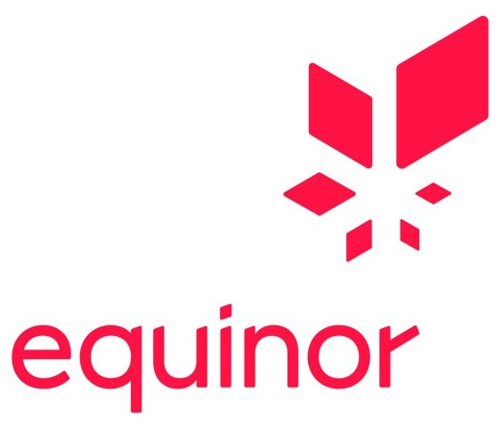
NOWRDC Board Members
Ron Schoff – Director - Renewable Energy and Fleet Enabling Technologies at EPRI
Christy Guthman – General Manager of Sales & Commercial Operations, North America, GE Offshore Wind
Scott Lundin – Head of US Permitting and Environmental Affairs at Equinor Wind
Adrienne Downey – Principal Engineer & Country Manager: US & Canada at Hexicon
Celina Cunningham – Deputy Director, Governor’s Energy Office, State of Maine

Slide 31
NOWRDC Board Members
Eric Coffman – Director of MEA
Nils Bolgen – Program Director- Offshore Wind at the MassCEC
John Bruckner – Former President at National Grid
Robert (Bob) Brabston – Executive Director at New Jersey Board of Public Utilities
Doreen Harris – President and CEO of NYSERDA

Slide 32
NOWRDC Board Members
Kevin Hansen, Head of Government Affairs & Policy, New York, at Ørsted
Currently Vacant
Michael Brown – Country Manager US at Ocean Winds
Wojciech Wiechowski – Senior Business Development Manager USA at RWE Renewables
Ruth Perry, Head of Regulatory Affairs, Offshore Power Americas, at Shell
Bob Catell – Chairman of the Board of the Advanced Energy Research and Technology Center (AERTC) at Stony Brook University

Slide 33
NOWRDC Board Members
Al Christopher – Director of the Department of Energy at Commonwealth of Virginia
Nick Prokopuk – Offshore Wind Business Developer at TotalEnergies
Jordan Shoesmith – Project Manager at Vineyard Wind
Jan Klaasen – Business Unit Director
Yasser Bangash – Business Unit Director
Cameron Willard – Director of Commerical Management

Slide 34
NOWRDC Board Members
Jonah Steinbuck – Director of Research & Development Division, California Energy Commission
Kevin Knobloch – President of Knobloch Energy

Slide 35
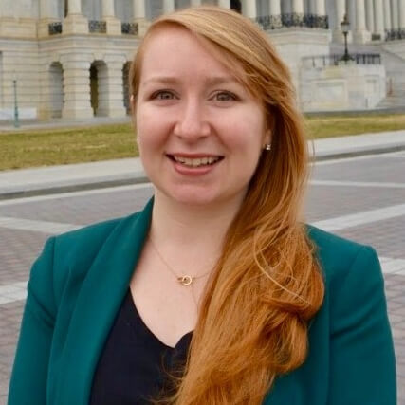
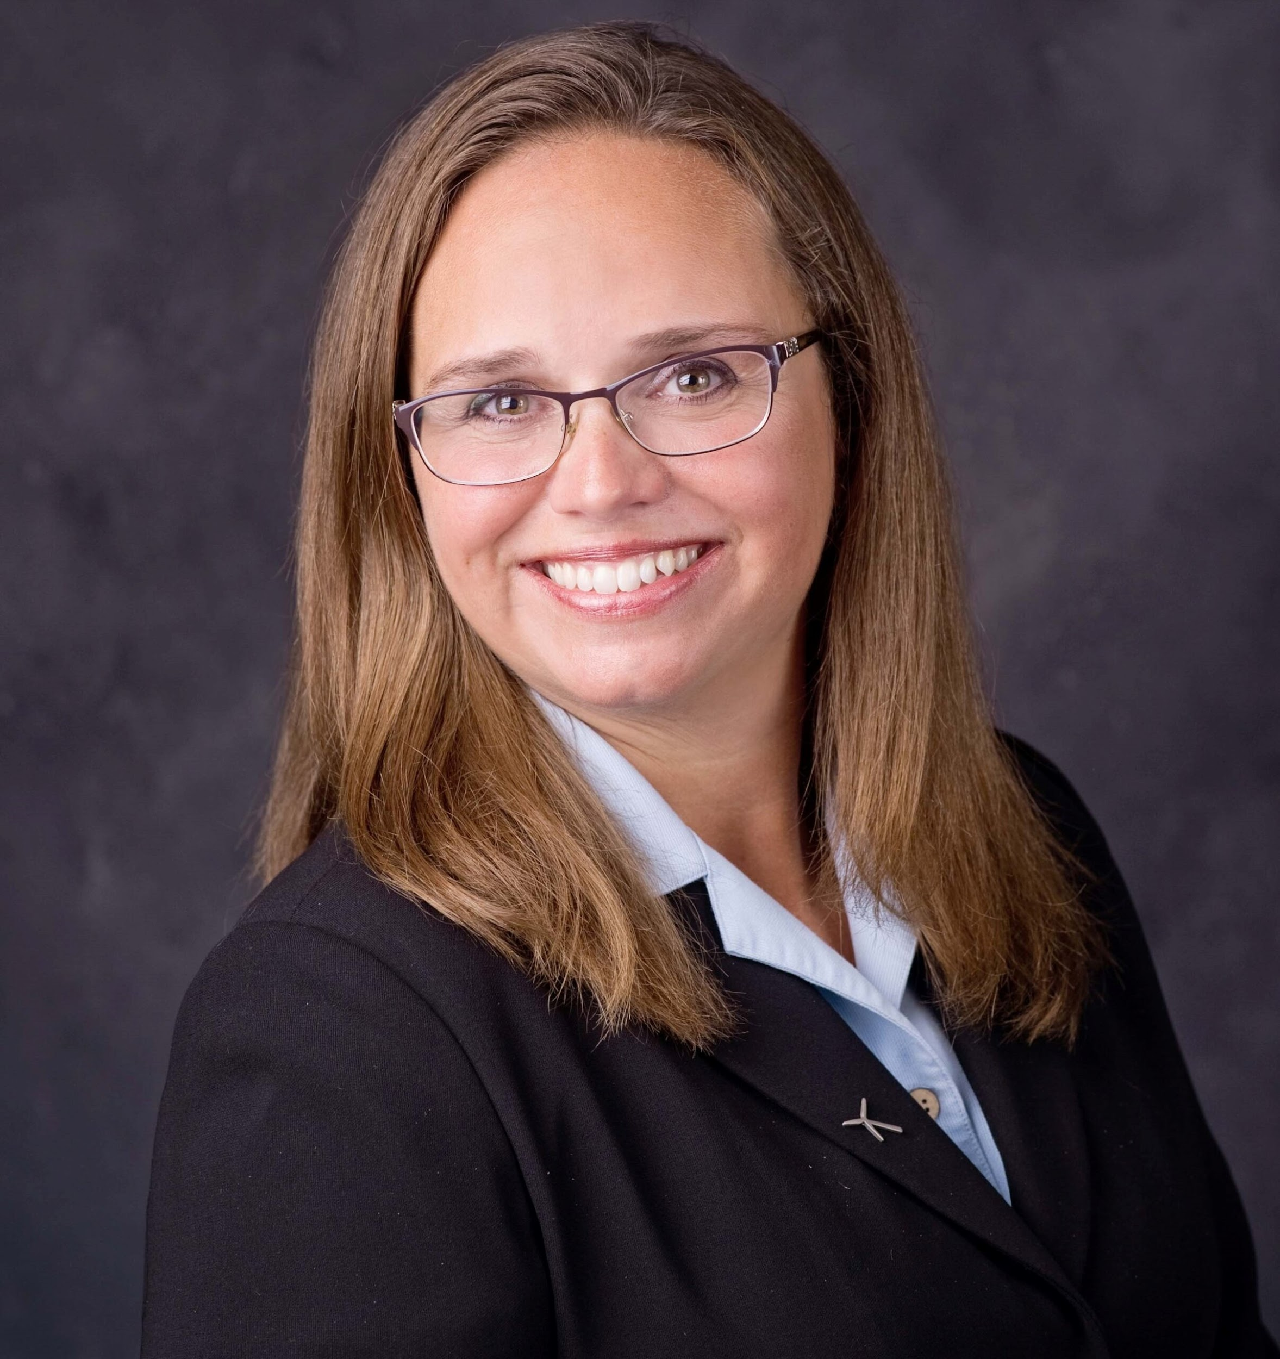
NOWRDC Core Staff
Lyndie Hice-Dunton, PhD
Executive Director
Julia Dombrosky, PhD Offshore Wind Innovation Hub Associate
Kori Groenveld Senior Program Manager
Melanie Schultz
Program Manager
Julian Fraize Program Manager
Christine Sloan Deputy Executive Director

